Slide 1

OPIM628 - Business Analytics and Quantitative Methods
Kaggle Competition
https://www.kaggle.com/c/smu-opim-628-2020-Jul/leaderboard

Slide 2
Regression Models
1
Week 6 Submission

Slide 3
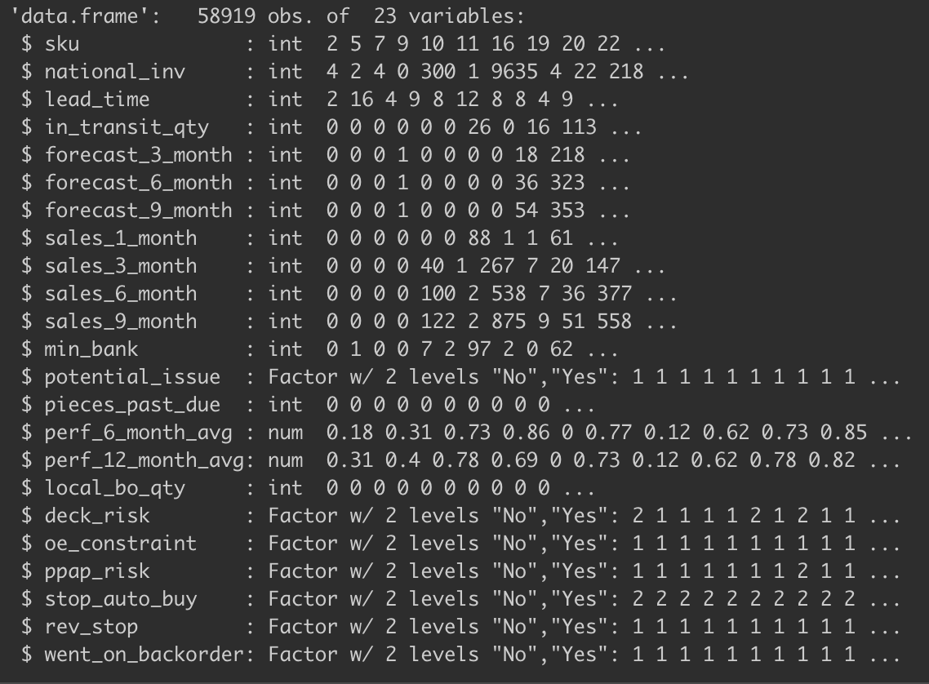
Data Analysis
22 Independent variables.
16 numerical variables
6 categorical variables
One outcome variable
Categorical
Classification problem

Slide 4
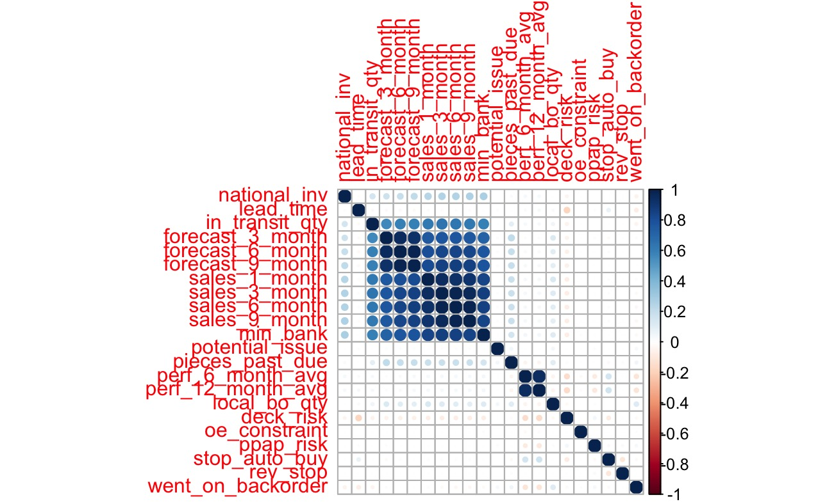
Data Analysis – Visualization
Variable correlation analysis
Notes:
Next, we plot a simple correlation map, we can see from the last column that almost no variable has strong correlation with went_on_backorder(dependent variable).
From the middle part, the forecast and sales variables are highly correlated, as well as the perf_6_month_avg and perf_12_month_avg.
These correlation may cause multicollinearity in our model.

Slide 5
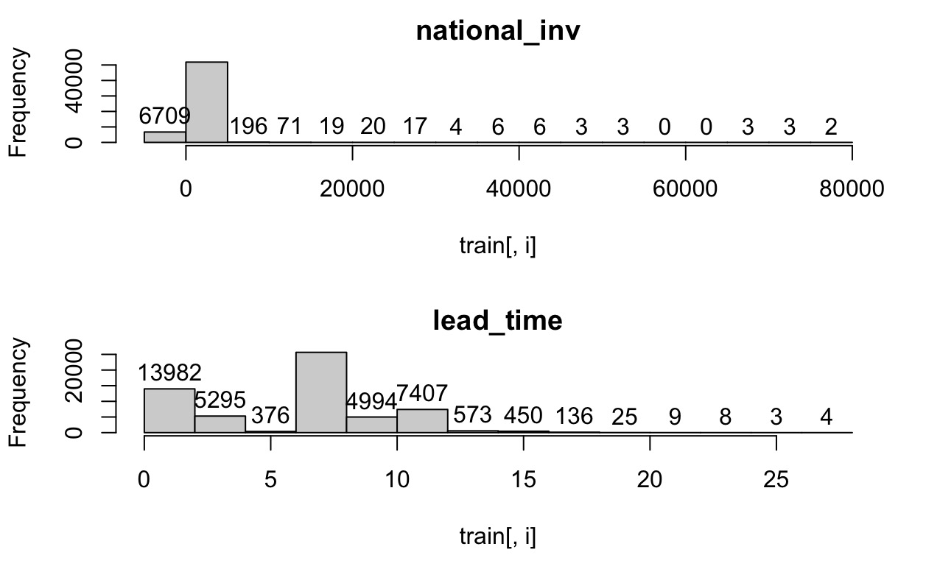
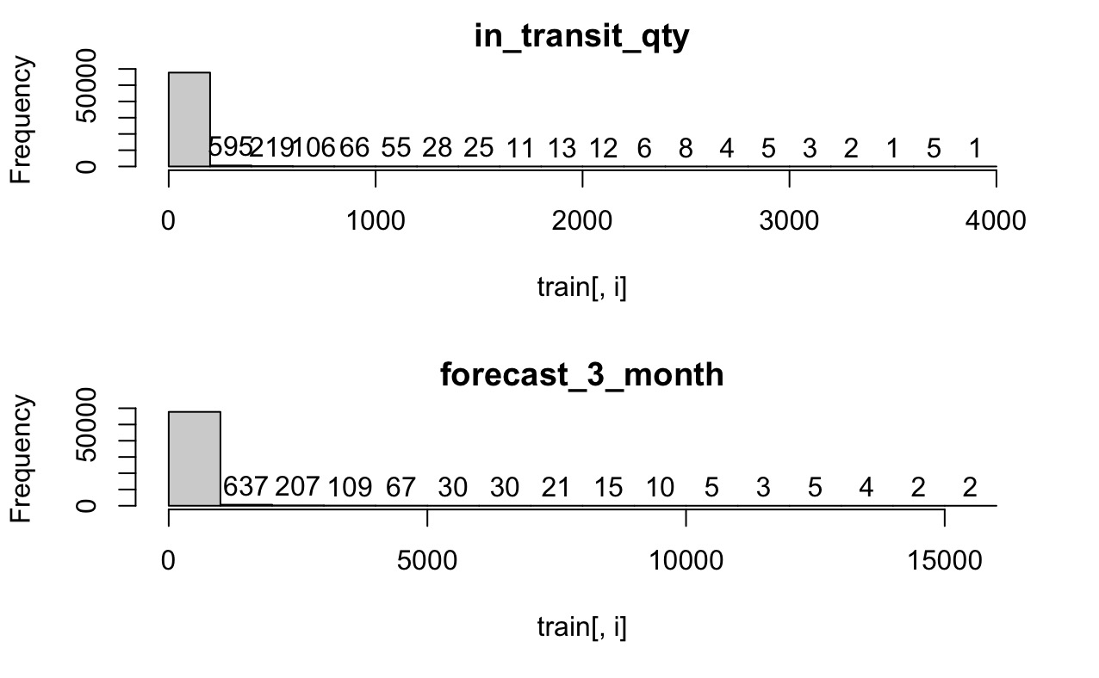
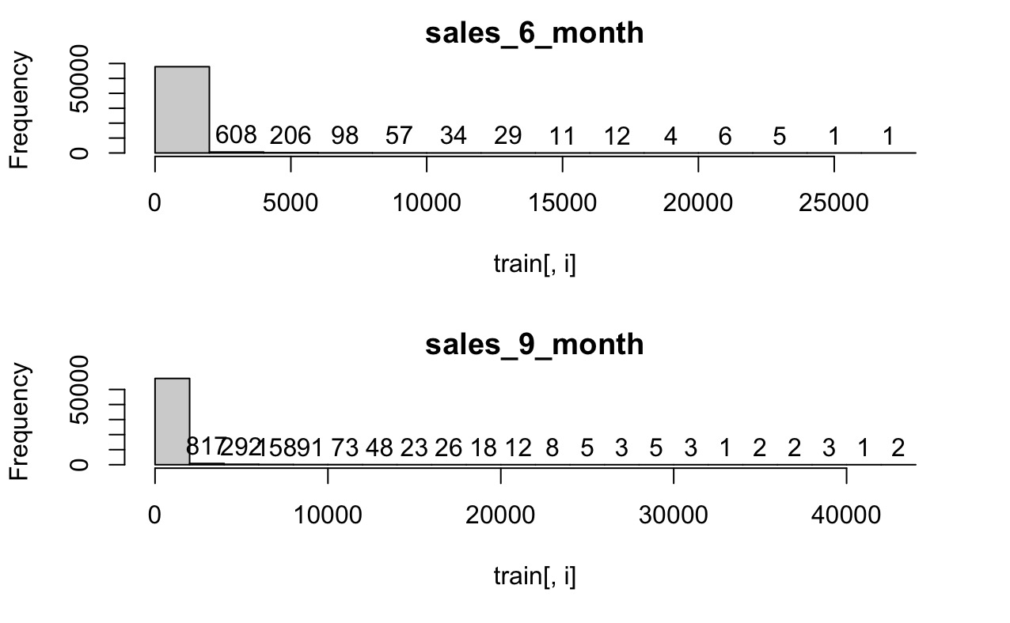
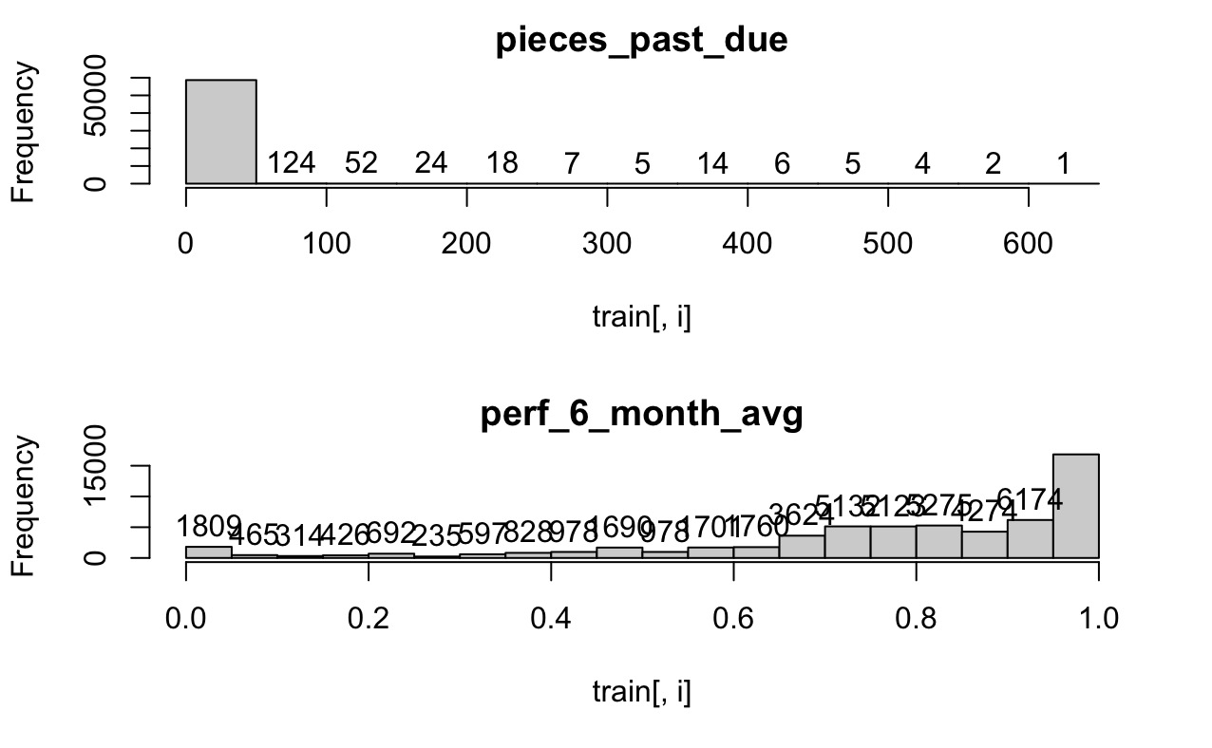
Data Analysis – Visualization
Variable distribution analysis – Histogram
Highly skewed dataset
Notes:
From the histogram we can see that all of our numerical independent variables are highly skewed to the right, and the performance_6_month average variable are skewed to the left
Almost no variable are distributed evenly across different values. And these skewed data may significantly affect parametric models such as linear and logistic regression.

Slide 6
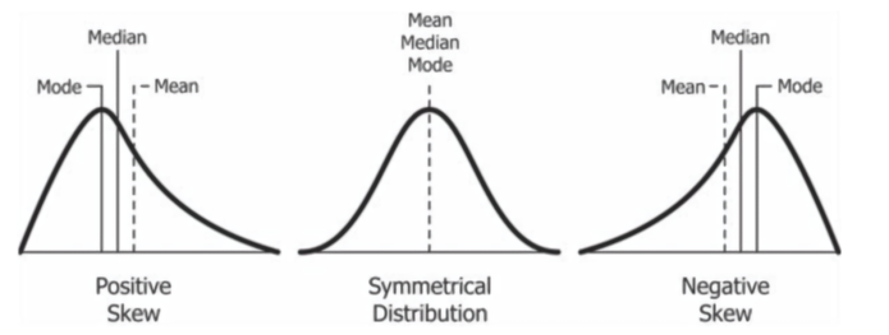
Data preprocessing
Linear and logistics regression work best when data is normally distributed.
Normal distribution
Models created from skewed data is less interpretable by human
No quality data, no quality prediction
Violate the rule of data science
- garbage in, garbage out
The outlier will be magnified - causing overweighting
Notes:
Skewness of the dataset may cause various problems.
Firstly, Parametric prediction models generally based on the assumptions that the data is normally distributed, therefore skewed data may affect the overall accuracy of the model.
Secondly, skewed data are generally less interpretable by human, even if the model is perfect.
Thirdly, it violate the rule of garbage in garbage out, and those outlier values may cause the model to overweight certain variables

Slide 7
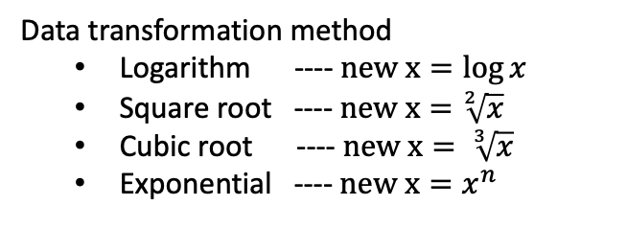
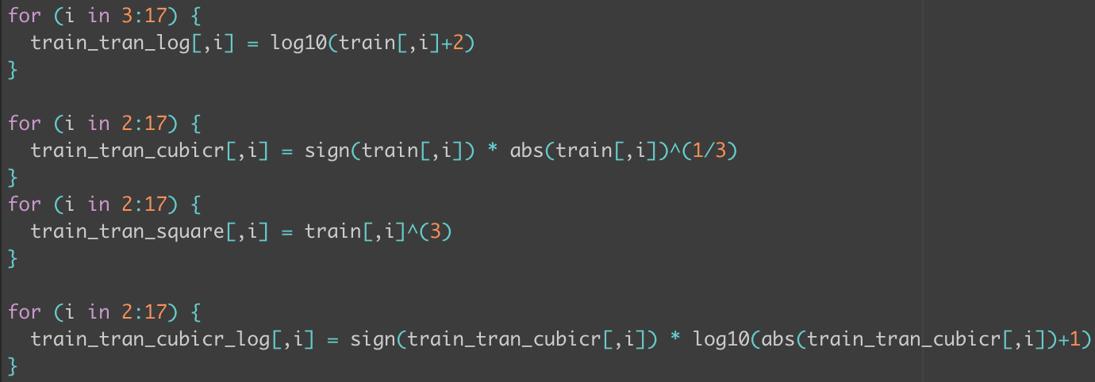
Data transformation
Implementation
Notes:
To make the data distribute evenly,
We can use data transformation techniques such as log, square root, cubic root.
In our model, we have implemented all three of these method, the national inventory variable contains a lot of negative values, so we exclude this variable in log transformation.

Slide 8
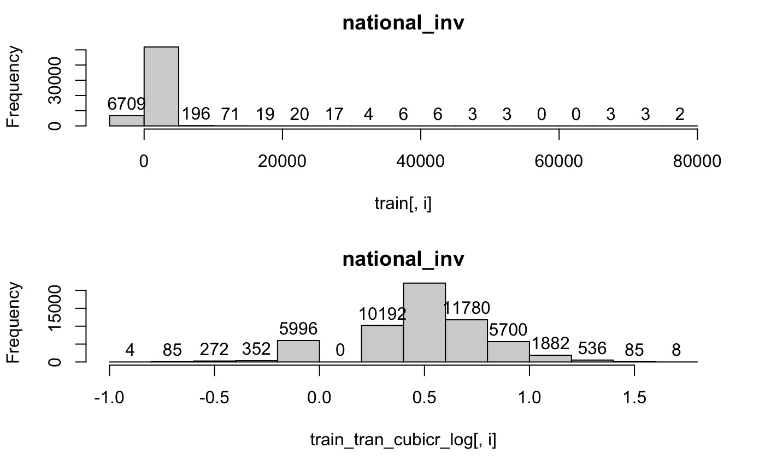
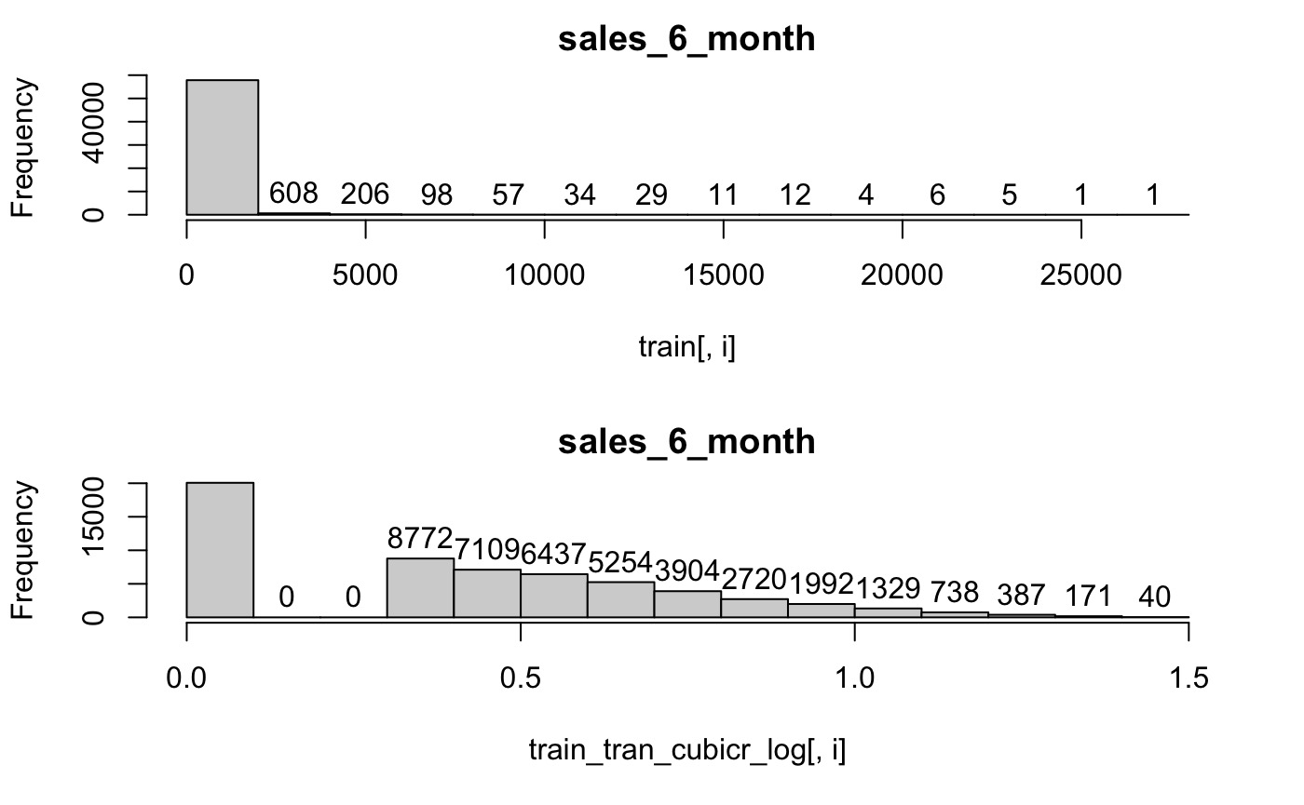
Data transformation
Compare processed data with original dataset
before
Much closer to the shape of normal distribution
Shift observations to evenly distribute across different value
Scale down the variables to avoid overweighting of the model
We take cubic root as our data transformation method (refer to the code)
after
before
after
Notes:
After the transformation, we can clearly see that the data is distributed across different values.
Although some features are still skewed to the left, but compare to the original dataset, processed data are closer to the shape of normal distribution.
Which is a significant improvement.
By making observations value distribute evenly, we have also scaled down the variable, making variables less extreme, hence avoid overweight of the model training

Slide 9
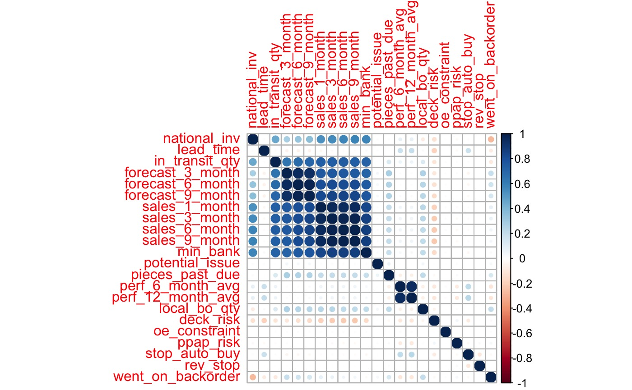
Data transformation
Compare processed data with original dataset
Original dataset
Notes:
We can also see there is an improvement on correlation plot.
The correlation between independent variable and dependent variable are much more clear compare to original.

Slide 10
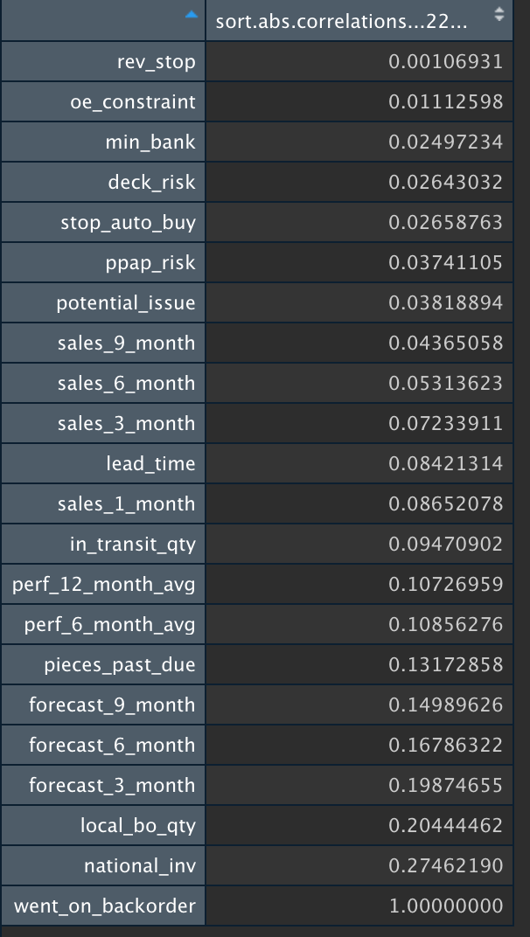
Feature selection
For 22 variables, there are 2^22 = 4194304 combinations.
It not possible to try every combination.
Less variable
more likely to overfit
More interpretable model
More variable
Less likely to overfit, more accurate for prediction
Hard to interpret the model
We select variables based on correlations.
Compute based on processed dataset
Using |absolute value| for better comparison
Notes:
Next step, variable selection
In this dataset, 22 independent variables means there are more than 4 millions of combination, so, it is not possible to try every combination
We use the correlation value as a guideline to select our model. These correlation value are computed using processed dataset, not the original data.

Slide 11
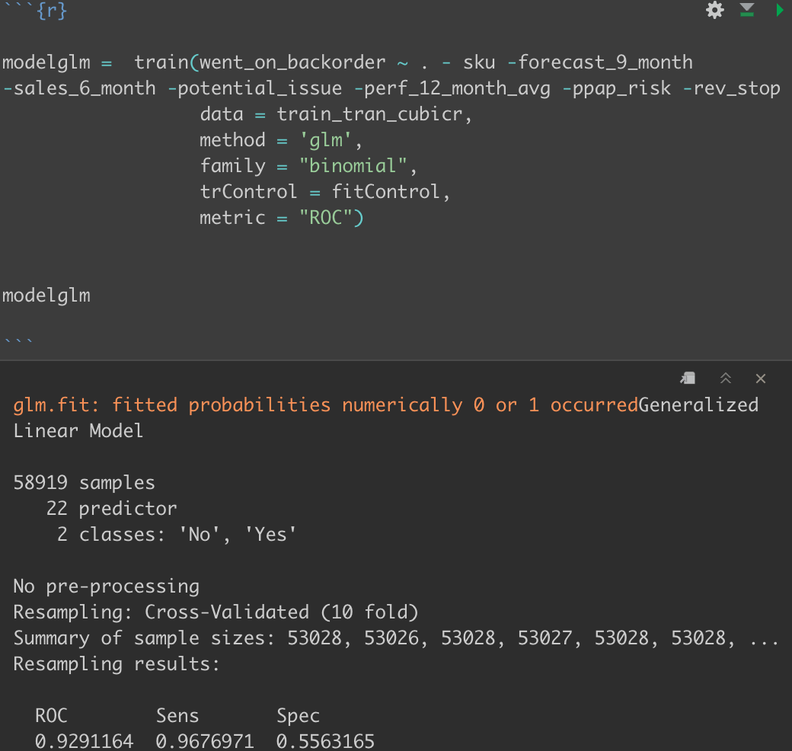
Final model - week 6 submission
Final logistic regression models
In sample performance
(Intercept) | 0.53701714
national_inv | -1.52935140
lead_time | -0.59336217
in_transit_qty | -0.88990768
forecast_3_month | 0.03186116
forecast_6_month | 0.21719772
sales_1_month | 0.61827768
sales_3_month | 0.51584239
sales_9_month | 0.14107363
min_bank | -0.13025940
pieces_past_due | 0.11783743
perf_6_month_avg | -0.55871499
local_bo_qty | -0.87635617
deck_risk | -0.26180882
oe_constraint | 2.19472146
stop_auto_buy | 0.25462439
ROC | 0.9291164
Notes:
After selection, we build our final model using these variables, coefficient and intercept are as shown.
And our in-sample ROC performance is around 0.929. and it is a significant increase compare using original dataset.

Slide 12
Decision Tree Models
2
Final Submission

Slide 13
Data analysis - decision tree models
Decision tree models are nonparametric models
No data transformation required
Use original dataset
Data imbalance
Observations that went on back order is yes only compose 15.8% of the data
Imbalance may cause the model to learn a tendency – ”No” is more likely to happen.
Can be solved by up-sampling or down-sampling
Notes:
For decision tree models, data transformation is not a requirement. So we just use the original data without modification.
But if we look at the value in went_on_backorder column, the dataset is highly imbalanced, most of the observations are 0 and only 18.7% of the observation is 1.
This imbalance may cause the model to learn a tendency that 0 is more likely to happen and 1 is less likely to happen. Hence it may affect the accuracy.

Slide 14
Data analysis - decision tree models
Up sampling
- Duplicate the minority observations
Down sampling
- Reduce the number of majority observations
Compare models with up-sampling and without sampling
Without sampling |  | Actual
 |  | Yes | No
Predictions | Yes | 6850 | 1584
 | No | 2445 | 48040
 |  | Sensitivity | Specificity
 |  | 0.737 | 0.968
With up-sampling |  | Actual
 |  | Yes | No
Predictions | Yes | 7522 | 2434
 | No | 1773 | 47190
 |  | Sensitivity | Specificity
 |  | 0.809 | 0.950
Notes:
The common practices dealing with imbalanced data is Up sampling and Down sampling
The goal is to achieve a reasonable proportion. Like 50:50, or any number that is consider acceptable.
For our case, we have build two models to demonstrate the difference. One model without any sampling technique, one with up sampling.
We can see that the sensitivity or second model is much higher that first model. Which means models with up sampling, will predict Yes more accurately.

Slide 15
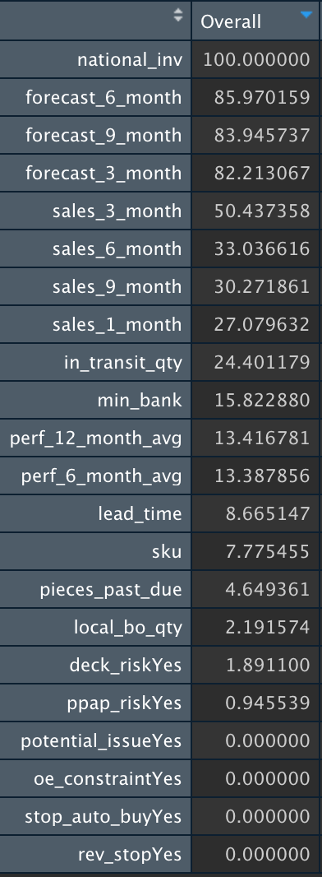
CART model - importance value
Variable importance
Train with all variable to extract importance value
Select variables based on the importance value.
Sometimes zero importance doesn’t mean it has no effect on the accuracy(or roc)
High importance value doesn’t mean it is meaningful – such as sku
Notes:
For CART model, we firstly train with all variables, and extract the importance value as shown in the table.

Slide 16
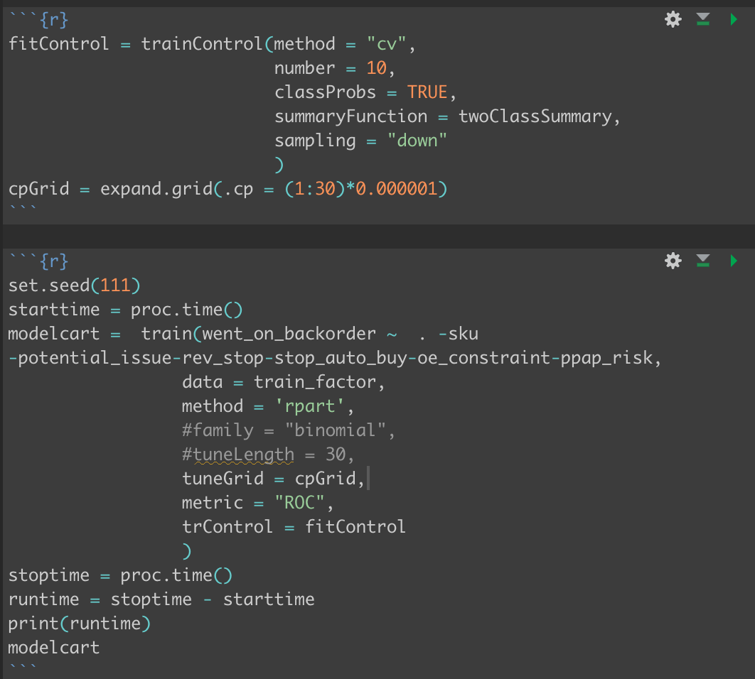
CART model
In CART model, we adopted down sampling method
Run a grid search to find the best cp value
cp = 0.000029
Result from best tuned model
ROC = 0.9236126
Notes:
For our final CART model,
We use the cp value = 0.000029
And the insample performance is 0.9236 which is not ideal. Let's move to random forest model.

Slide 17
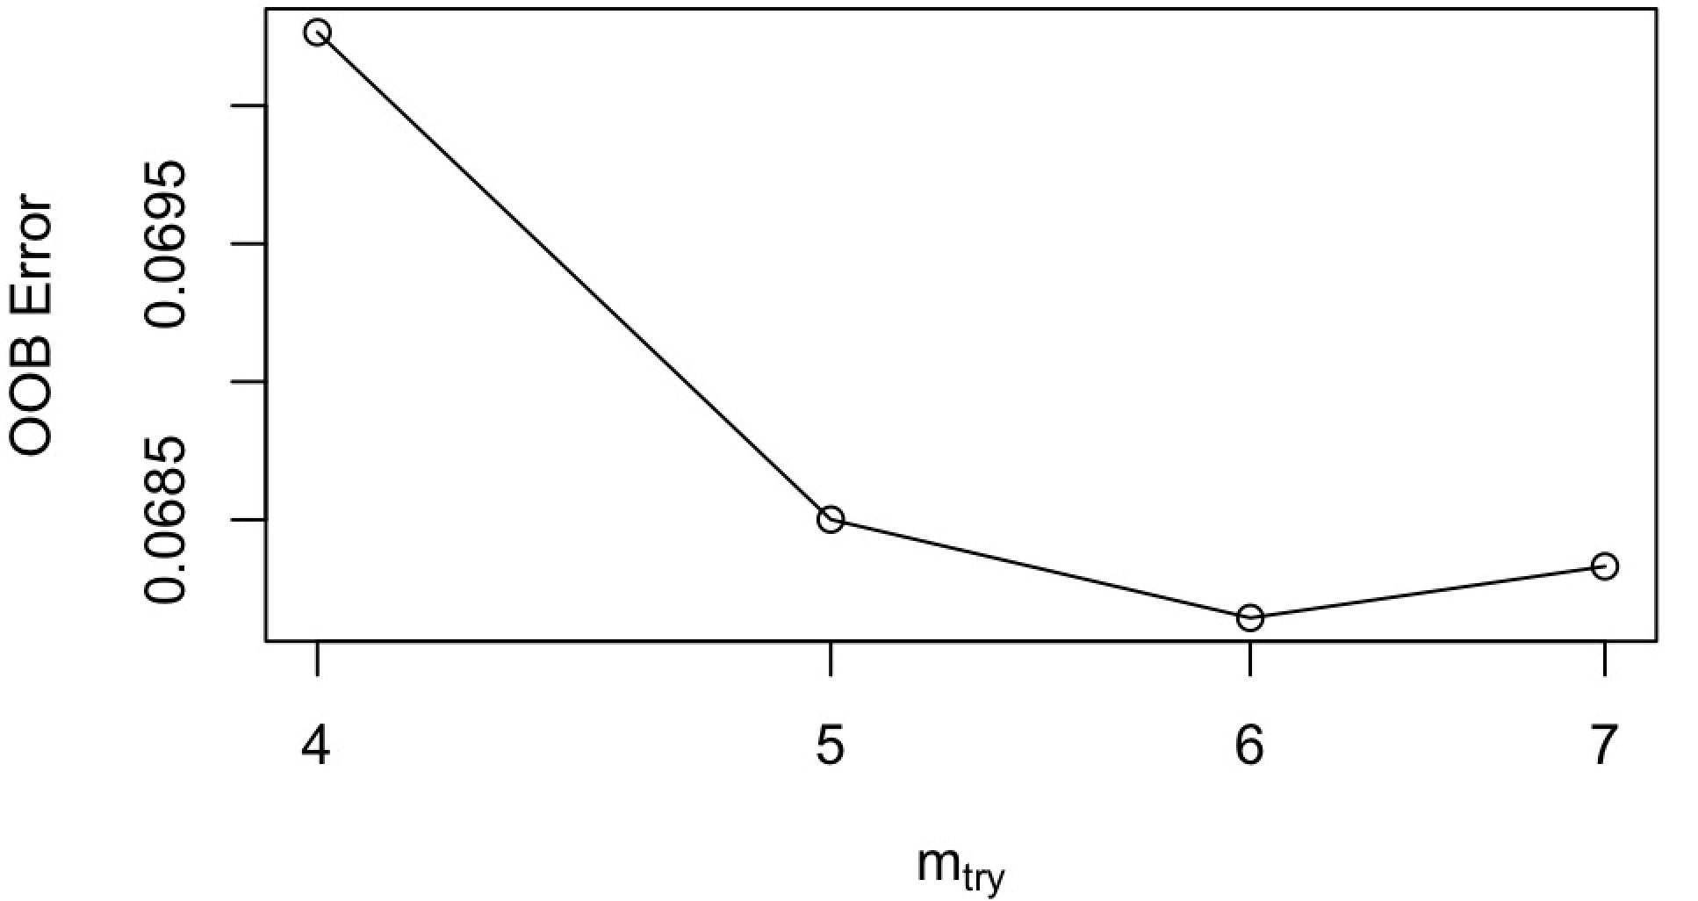
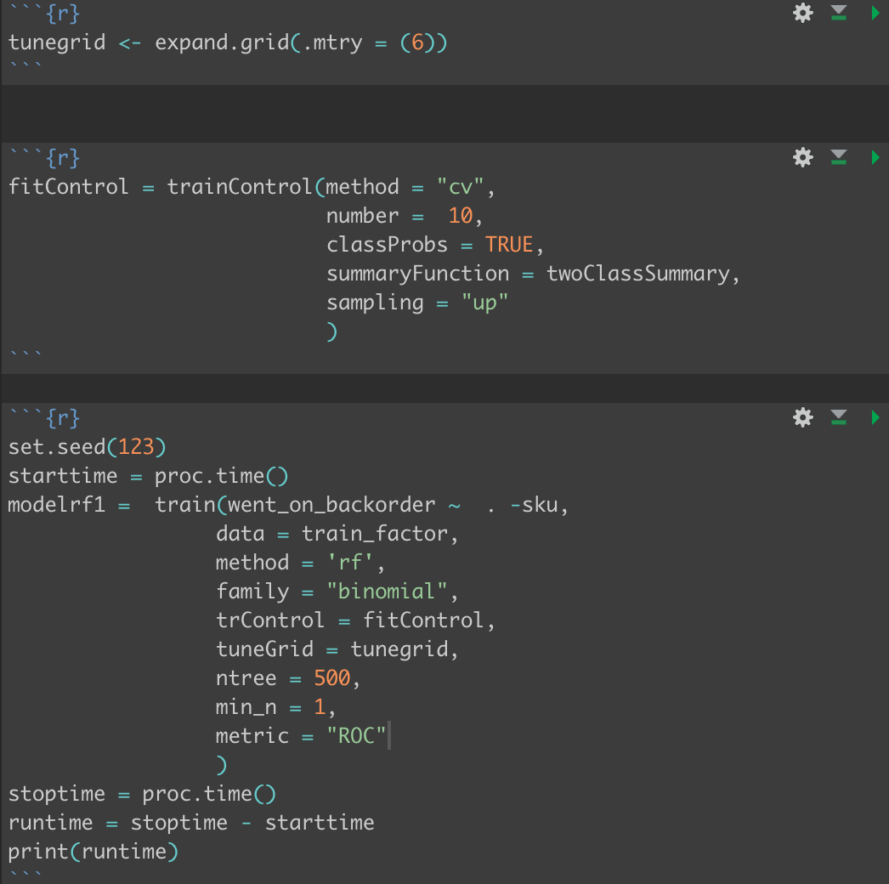
Random forest – parameter tuning
mtry = 6, out-of-bag(OOB) error is the lowest
tuneRF() function is applied to find the best mtry value
Ntrees = 500
- Just because of insufficient of computer memory
Notes:
Come to random forest models, first we need to look at the parameters we have set
We use tuneRF() function in random forest package to find the best mtry value. (it takes quite long to run)
We can see from this chart, OOB error is the minimum when mtry = 6
Ntree is set to 500, it may not the optimum value, but it probably the largest value my laptop is able to handle. Any larger value causes R to break.
we use up sampling to train this model.

Slide 18
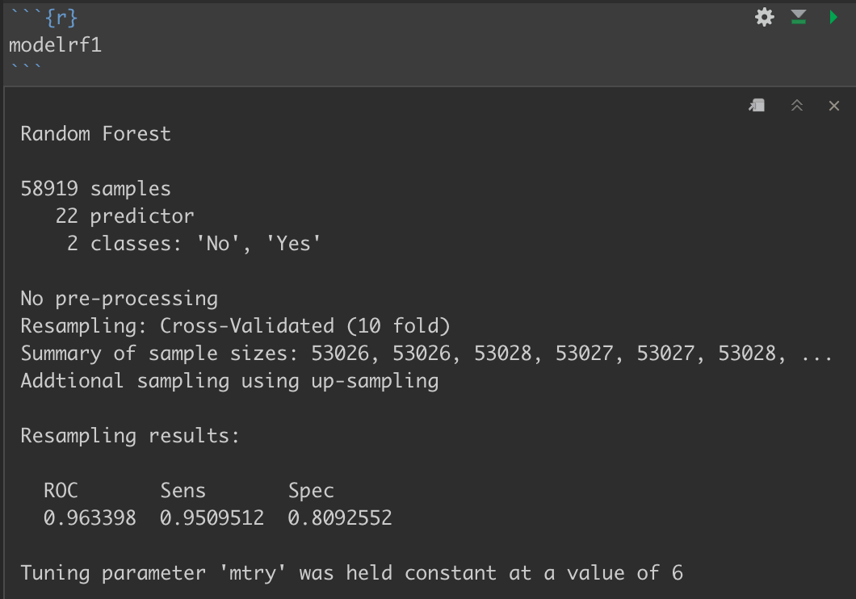
Random forest
Final model
use all variables except sku
up sampling is adopted
mtry=6
min_n=1
ntree=500
Model performance
In sample performance:
ROC | 0.963398
Notes:
Final model

Slide 20
Thank you for watching

